Slide 1
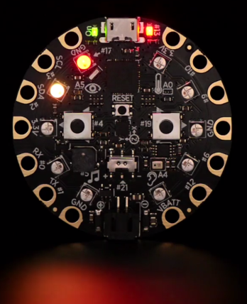

Workshop on Wearables Using Adafruit’s Circuitplayground

Slide 2

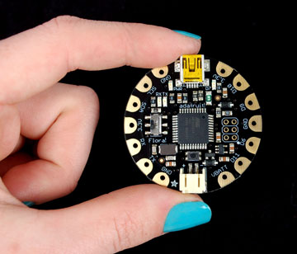
Session 1: Basics of Circuit Playground

Slide 3
Session 1: Lesson Plan
Today’s Plan
Understand each other
Pre-Requisite
Each Laptop has been loaded with Arduino IDE (1.6.4 or more)
Arduino IDE has CircuitPlayground libraries Installed using https://learn.adafruit.com/introducing-circuit-playground
Tour of the Circuitplayground
See https://learn.adafruit.com/circuit-playground-lesson-number-0?view=all
Pixels, music, touch, motion
Blink Sketch: Load, Compile & Run
Blink Sketch
Hands ON: Download Blink Sketch
Hands ON: Vary the Blink sketch frequency
Printing, Serial Monitor
Opening a Serial Monitor
Showing messages with Serial Monitor (and blinking)
Understand code, upload, run – cycle
Understand basic “Blink” program
The Demo program of Adafruit is successful
Microprocessor
Examples of Microprocontroller applications
Working ROBOT
Working Circuitplayground
Debug
Understand Microcontrollers, Circuitplayground (one kind of microcontroller)

Slide 4
Details of Session 1 – Team Intros, Micro Controllers
Introductions (Around the table)
Name, Grade, School, Interests
About the Instructor
Name, Grade, School
Demo of 2 Wheel Robot
Demo – touch/see the parts: Wheels -
Video of 4 Wheel Robot
5 Minute Video: https://www.youtube.com/watch?v=BwCCtqTTkEI
What are Micro Controllers?
Arduino UNO (First open source Micro Controller)
Why you are Here?
Any prior experience with Micro Controllers? Wearables?
Interests: IGEM and Biology, Electronics, Kinemeter
Current Work: Electricity & Magnetism, Faraday’s law
Goals: Making physics labs for everyone
Pass around “UNO”. And, then “Metro” – same but miniaturized
It means your designs are open, your instruction is open – but goods & Services paid
Micro Controller, Bluetooth, Controlling App.
Not in scope for this class, but demos Micro Controllers
What is “Open Source” Hardware? Does not mean “Free”.
A discussion

Slide 5
Verify Circuit Playground Works in the IDE
Arduino IDE Installed for each?
Is Circuitplayground in the list
IF problems:
Ask a local Systems Adminstrator
Install Arudino IDE
Compile Blink
Download a Blink Code
Compile
Don’t expect to understand for now
Check for each Student

Slide 6
Details of Session 1 – Circuitplayground “Walkthrough”
Circuitplayground
Adafruit Inc. manufactures this circuitplaygrund in NYC
Sensors
Touchpads (we’ll see them in action later in a different session)
Outputs
Neopixels
A 1 minute video: https://www.adafruit.com/product/3000
Microphone
Buttons (we’ll use them). Allow control
Buzzer “Noise Maker” (Beware Parents!)
No Breadboards (Show an example of Breadboard)
A microcontroller 32u4 and a bunch of sensors and Output devices
Controller
Main Microcontroller (Show in the PCB)
Latch – special kind of button – we’ll experiment
ACCELEROMETER
USB Connection
Battery Connection
Lipoly Battery
Charging the battery

Slide 7
BREAK – 15 Minutes

Slide 8
Details of Session 1 – 8 Steps of Arduino Coding - Basic
Arduino IDE Usage – 8 Steps
Instructubles Arduino Coding – 8 Step Process:
We’ll also see Variations: 3 Programs
Classic
Sid's GearsnGenes INstructable Link
Everyone Opens IDE
Downloads “Blink”
Runs it
Serial Print
Variations

Slide 9
Code-Analysis: Blink Classic: Now that it works, what & Why
#include <Adafruit_CircuitPlayground.h>
#include <Wire.h>
#include <SPI.h>
void setup()
{
CircuitPlayground.begin();
}
// the loop function runs over and over again forever
void loop() {
CircuitPlayground.redLED(true); // turn the LED on (HIGH is the voltage level)
delay(1000); // wait for a second
CircuitPlayground.redLED(false); // turn the LED off by making the voltage LOW
delay(1000); // wait for a second
}
Includes: Libraries
Setup: one time deal. Initializes Circuit playground
Comment
loop: over and over
functions

Slide 10
Code-Analysis: Serial Write: Now that it works, what & Why
#include <Adafruit_CircuitPlayground.h>
#include <Wire.h>
#include <SPI.h>
void setup() {
Serial.begin(9600);
CircuitPlayground.begin();
}
// the loop function runs over and over again forever
void loop() {
Serial.println("LED on");
CircuitPlayground.redLED(true);
delay(1000);
Serial.println("LED off");
CircuitPlayground.redLED(false);
delay(1000);
}
New functions

Slide 11
Code-Analysis: Blink Frequency: what & Why
#include <Adafruit_CircuitPlayground.h>
#include <Wire.h>
#include <SPI.h>
int t1=0;
int t2=1;
void setup() {
CircuitPlayground.begin();
Serial.begin(9600);
}
// the loop function runs over and over again forever
void loop() {
//define your time functions
t1=t1+1 //Time increases linearly
t2=5*t2 //Time increases Geometrically
Serial.println("LED on");
CircuitPlayground.redLED(true);
delay(/*Function of time*/);
Serial.println("LED off");
CircuitPlayground.redLED(false);
delay(/*Function of time*/);
}
}
New functions

Slide 12
QA, Recap and See you Tomorrow (Session 2)

Slide 13
Session 2: Wearable Brooch

Slide 14
Session 2: Lesson Plan
Recap
A Wearable Necklace
With color patterns: Xmas, Halloween, July 4th or “your own”
RGB Math: MSWord
Use MSWord to show how “colors” are produced as combination of R, G, B
Show different colors
Hands ON: Light one RGB Pixel in CircuitPlayground
How to produce colors in CircuitPlayground in one pixel
Producing colors in 2 pixels
Hands ON: Light multiple RGB Pixels
Introducing Arrays and Modular Math
Hands ON: Printline 10 numbers over and over with a loop
Hands ON: Printline 10 numbers “Circular” – after 9, 0 comes. Modular math
Hands ON: Patterns of X-Mas Halloween, July 4 or Your own
Using Array and Modular math to Color LEDs Hands ON: Modular Math on 10 LEDs in Circuit Playground – make a pattern
Hands ON: Demonstrating Xmas, Halloween, July4 or your own pattern
Today’s Application
What we learnt? Questions on Previous Session?

Slide 15
Details of Session 2 – RGB Math
Today’s Application
Demo the Patterns
What is Color?
MS Word – COLOR Pattern
Colors in the NeoPixel
You tell 4 things:
Talk about NeoPixels
Pass the Circuitplayground around – to ensure everyone understands the pixel numbers
Color Number = 0-255.
R =255, G = B= 0 → “Pure Red”.
Similarly other colors
Pixel number, R-value, G-Value and B-Value.

Slide 16
Code-Analysis: One Neopixel
#include <Adafruit_CircuitPlayground.h>
void setup()
{
// Initialize Circuit Playground library.
CircuitPlayground.begin();
}
void loop(){
// Parameters are (pixel number, red value (0 to 255), green value(0 to 255), blue value (0 to 255)
CircuitPlayground.strip.setPixelColor(0,255,0,0);
CircuitPlayground.strip.show();
}
New functions
DON’T FORGET THIS – Or, you see nothing

Slide 17
Code-Analysis: Multiple Neopixels
#include <Adafruit_CircuitPlayground.h>
void setup()
{
// Initialize Circuit Playground library.
CircuitPlayground.begin();
}
void loop(){
// Parameters are (pixel number, red value (0 to 255), green value(0 to 255), blue value (0 to 255)
CircuitPlayground.strip.setPixelColor(0,255,0,0);
CircuitPlayground.strip.setPixelColor(2,0,255,0);
CircuitPlayground.strip.setPixelColor(5,0,0,255);
CircuitPlayground.strip.setPixelColor(8,255,255,255);
CircuitPlayground.strip.show();
}
Red, Green and Blue
And White
And Show.

Slide 18
Code-Analysis: Circle Pattern
#include <Adafruit_CircuitPlayground.h>
#include <Wire.h>
#include <SPI.h>
void setup()
{
// Initialize Circuit Playground library.
CircuitPlayground.begin();
}
void loop(){
for(int i=0; i<=10;i++){ //Our make shift "clock"; It plugs in an integer between and ten and increases by 1 each time.
CircuitPlayground.strip.setPixelColor(i-1,0,0,0); //Pixel number i-1 remains off
CircuitPlayground.strip.setPixelColor(i,0,255,0); //Pixel number i turns green
CircuitPlayground.strip.show();
delay(100);
}
}
i becomes 0 again at the beginning of the loop – making circle possible
Loop
Off
Red

Slide 19
Code-Analysis: Using Modulo Pattern
#include <Adafruit_CircuitPlayground.h>
#include <Wire.h>
#include <SPI.h>
void setup()
{
// Initialize Circuit Playground library.
CircuitPlayground.begin();
}
void loop(){
/* % means Modulus. It is used to find the remainder when you divide two integers.
* If a number is a multiple of its divider, then the remainder is zero. For example, 4%2=0.
* If not, then it spits out the nonzero remainder. For example, 5/3 has a remainder of two, so 5%3=2
*/
for(int i=0;i>=0;i++){//Our make shift "clock"; It plugs in an integer 0 and increases by 1 each cycle.
CircuitPlayground.strip.setPixelColor((i-1)%10,0,0,0); //Pixel number i-1 remains off
CircuitPlayground.strip.setPixelColor(i%10,0,255,0); //Pixel number i turns green
CircuitPlayground.strip.show();
delay(100);
}
}

Slide 20
Break 15 Minutes

Slide 21
Code-Analysis: Holiday Pattern
void loop(){
for(int i = 0; i < 5; i ++){
CircuitPlayground.strip.setPixelColor(2*i,100,0,0); //2i means even
CircuitPlayground.strip.setPixelColor(2*i+1, 0, 100, 0); //2i+1 means odd
CircuitPlayground.strip.show();
}
delay(500);
for(int i = 0; i < 5; i ++){
CircuitPlayground.strip.setPixelColor(2*i+1,100,0,0);
CircuitPlayground.strip.setPixelColor(2*i, 0, 100, 0);
CircuitPlayground.strip.show();
}
delay(500);
}
}

Slide 22
Code-Analysis: LeafShield Pattern
void leafshield(int r, int g, int b){
for(int i = 0; i>=0; i++){
CircuitPlayground.strip.setPixelColor(i % 10, r, g, b);
CircuitPlayground.strip.setPixelColor((i + 1) % 10, 0, 0, 0);
CircuitPlayground.strip.setPixelColor((i + 2) % 10, r, g, b);
CircuitPlayground.strip.setPixelColor((i + 3) % 10, 0, 0, 0);
CircuitPlayground.strip.setPixelColor((i + 4) % 10, r, g, b);
CircuitPlayground.strip.setPixelColor((i + 5) % 10, 0, 0, 0);
CircuitPlayground.strip.setPixelColor((i + 6) % 10, r, g, b);
CircuitPlayground.strip.setPixelColor((i + 7) % 10, 0, 0, 0);
CircuitPlayground.strip.setPixelColor((i + 8) % 10, r, g, b);
CircuitPlayground.strip.setPixelColor((i + 9) % 10, 0, 0, 0);
delay(600);
CircuitPlayground.strip.show();
}
}
Many More Patterns – Let’s Play

Slide 23
QA, Recap and See you Tomorrow (Session 3)

Slide 24
Day 3: Musicbox with Light Patterns
Today’s Application
A Musicbox with controllable lightpatterns
It plays various tunes
Hands ON: Producing a Single Tone
Using the buzzer on Circuitplayground
Hands ON: Producing a Tune
Identify a Tune
Hands ON: Use of a Button to control Music
Introducing Button in Circuitplayground
Hands ON: Use Two Buttons control Music & Colors
One Button press produces Tune
Frequencies and Sounds on a Buzzer
Produce the Frequencies in an Array
Run the array over and over
Introduce Procedures ‘encapsulate’ “Run the Tune
Debug
Another Button Produces Colors
Both produces both

Slide 25
Details of Session 3 – RGB Math
Today’s Application
Demo of Music
Single Tone
http://www.szynalski.com/tone-generator/
Circuit Playground Produces Sound
Give Frequency
Buzzer
Buttons – and Control
Various Frequencies – but one frequency at a time
Give How Long
It buzzes at that frequency for that long

Slide 26
Code-Analysis: Single Tone
#include <Adafruit_CircuitPlayground.h>
#include <Wire.h>
#include <SPI.h>
void setup() {
// put your setup code here, to run once:
CircuitPlayground.begin();
}
void loop() {
CircuitPlayground.playTone(131, 500); //Frequency of the note and for how long to play it (milliseconds)
delay(1000); //Time between notes "gap"
}}
Very easy to produce a tone
Almost like Neopixel light
Frequency & How long

Slide 27
Code-Analysis: A Tune
CircuitPlayground.playTone(329.63, 1400);
CircuitPlayground.playTone(261.63, 1400);
CircuitPlayground.playTone(293.66, 1400);
CircuitPlayground.playTone(246.94, 1400);
CircuitPlayground.playTone(261.63, 1400);
CircuitPlayground.playTone(220.00, 1400);
CircuitPlayground.playTone(207.65, 1400);
CircuitPlayground.playTone(246.94, 1400);
CircuitPlayground.playTone(329.63, 1400);
CircuitPlayground.playTone(261.63, 1400);
CircuitPlayground.playTone(293.66, 1400);
CircuitPlayground.playTone(246.94, 1400);
CircuitPlayground.playTone(261.63, 700);
CircuitPlayground.playTone(329.63, 700);
CircuitPlayground.playTone(440.00, 700);
CircuitPlayground.playTone(440.00, 700);
CircuitPlayground.playTone(415.30, 2800);
Part of a Tune

Slide 28
Code-Analysis: Controling – Single Button
If the Left button press = True
If the Left button press = False
void loop() {
if(CircuitPlayground.leftButton()){ //IF the Left button is pressed
CircuitPlayground.strip.setPixelColor(4,255,0,0); //Pixel number 4 (5th pixel) turns red
CircuitPlayground.strip.show();
}
else{ //"else" if the Left button is NOT pressed
CircuitPlayground.strip.setPixelColor(4,0,0,0); //Pixel number 4 (5th pixel) is off
CircuitPlayground.strip.show();
}
}

Slide 29
Break 15 Minutes

Slide 30
Code-Analysis: Controling – Buttons – AND Logic
If the Left button press = True
AND
If the RIGHT button press = True
void loop() {
if(CircuitPlayground.leftButton()&& CircuitPlayground.rightButton())//BOTH buttons must be pressed to turn on pixel
{
CircuitPlayground.strip.setPixelColor(4,255,0,0);
CircuitPlayground.strip.show();
}
else{
CircuitPlayground.strip.setPixelColor(4,0,0,0);
CircuitPlayground.strip.show();
}
}
Even if One button is off, Neopixel is off

Slide 31
Code-Analysis: Controling – Buttons – ORLogic
If the Left button press = True
OR
If the RIGHT button press = True
void loop() {
if(CircuitPlayground.leftButton()|| CircuitPlayground.rightButton())//BOTH buttons must be pressed to turn on pixel
{
CircuitPlayground.strip.setPixelColor(4,255,0,0);
CircuitPlayground.strip.show();
}
else{
CircuitPlayground.strip.setPixelColor(4,0,0,0);
CircuitPlayground.strip.show();
}
}
ONLY IF BOTH BUTTONS ARE OFF, the Neopixel is off

Slide 32
Code-Analysis: Controling – Buttons – Music & Light
void spiralRed()
{
for (int i = 0; i <= 10; i++) {
CircuitPlayground.strip.setPixelColor((i - 1) % 10, 0, 0, 0);
CircuitPlayground.strip.setPixelColor(i % 10, 255, 0, 0);
CircuitPlayground.strip.show();
delay(50);
}
CircuitPlayground.strip.setPixelColor(0, 0, 0, 0);
CircuitPlayground.strip.show();
}
void Song()
{
CircuitPlayground.playTone(261, 300);
CircuitPlayground.playTone(294, 300);
CircuitPlayground.playTone(330, 300);
CircuitPlayground.playTone(349, 300);
CircuitPlayground.playTone(392, 300);
CircuitPlayground.playTone(440, 300);
CircuitPlayground.playTone(494, 300);
CircuitPlayground.playTone(523, 300);
}
Concept of Functions, New Tabs

Slide 33
Code-Analysis: Controling – Buttons – Top Level LOOP
If the Left button press = True and NOT the RIGHT Button, Produce Colors
void loop() {
if(CircuitPlayground.leftButton()&&!CircuitPlayground.rightButton())
{
spiralRed();
Serial.println("Left");
}
else if(CircuitPlayground.rightButton()&&!CircuitPlayground.leftButton())
{
Song();
Serial.println("Right");
}
}
If the RIGHT button press = True and NOT the LEFT Button, Produce MUSIC
11:15-11:50

Slide 34
QA, Recap and See you Tomorrow (Session 4)

Slide 35
Session 4: Touch Me NOT
Today’s Application
Anti-Stalker Backpack Security
If someone touches your back, it makes noise and/or produces colors
Hands ON: Demo of a Capacitive touchpad
Serial print “Touched”
Serial print “Untouched”
Touch Hands ON: Hook up colors and sounds
One Capacitive touch produces beeps and colors using neopixels
RGB Hands ON: Multiple Capacitive Sensors
A gentle touch → Friend (nice jingle)
A strong grip → stranger danger (bad noise and red color)
More patterns by students.
Capacitive Touch Sensors and Fruits
Simulating “Vegetables/Fruits” as piano steps
“Makey-makey” demo can be done on Circuit Playground

Slide 36
Session 4: Touch Pad - Basics
#include <Wire.h>
#include <SPI.h>
#include <Adafruit_CircuitPlayground.h>
int touchpad=3;
void setup() {
Serial.begin(9600);
CircuitPlayground.begin();
}
void loop() {
int Pressure=CircuitPlayground.readCap(touchpad);//detectst the touch a pad recieves
Serial.print("Capsense #3: "); Serial.println(Pressure);//Outputs the relative value of the force acting on the pad
}
Measuring the pressure on the touchpad 3
Printing the Pressure

Slide 37
Session 4: Real Touch versus Noise
Minimum number > Noise
void loop() {
int Pressure=CircuitPlayground.readCap(touchpad);//detectst the touch a pad recieves
if(Pressure>50){
Serial.println("Capsense #3: Touched");
CircuitPlayground.strip.setPixelColor(1,255,0,0);
CircuitPlayground.strip.show();
}
else{
Serial.println("Capsense #3: Untouched");
CircuitPlayground.strip.setPixelColor(1,0,0,0);
CircuitPlayground.strip.show();
}
delay(100);
}
Recognize Touch. Neopixel ON
No Touch → Neopixel is off

Slide 38
Session 4: Friend or Foe?
Minimum number > Noise
int touchpad=3;
void setup() {
Serial.begin(9600);
CircuitPlayground.begin();
}
void loop() {
int Pressure=CircuitPlayground.readCap(touchpad);//detects the touch a pad receives
if(Pressure>50&&Pressure<300){
fill(125,255,0);
Serial.println("Friend Incoming!");
}
else if(Pressure>=300&&Pressure<1000){
fill(255,0,0);
Serial.println("STRANGER DANGER!!");
}
else{
fill(0,0,0);
}
delay(100);
}
Recognize Touch. Neopixel ON
Gentle touch == Friend
Show nice colors
Harsh touch == Foe – stranger danger
Show scary color (RED)
No Touch == Clear every thing.

Slide 39
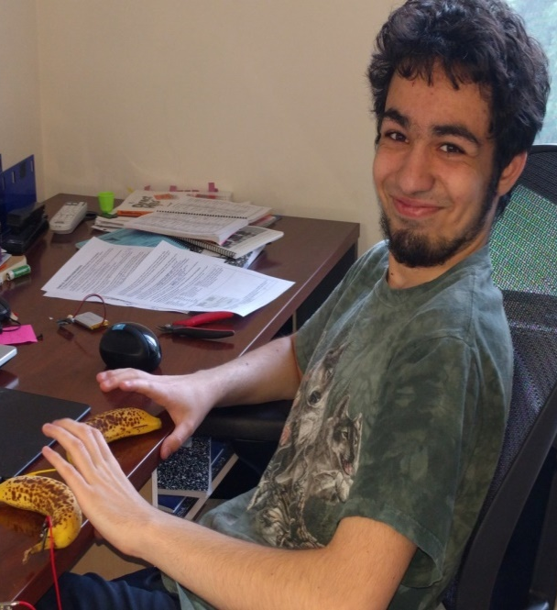
Session 4: Fruit Music?
You can make piano with Fruits – Oh and Circuitplayground (Of course!!)
Capacitive Touch can transmit through Fruits
Need Fruits and Alligator Clips

Slide 40
Session 4: Single Fruit Touched
void loop() {
int Pressure = CircuitPlayground.readCap(Banana); //detectst the touch a pad recieves
if (Pressure > 50) {
Serial.println(“Fruit: Touched");
CircuitPlayground.playTone(262,300);
CircuitPlayground.strip.setPixelColor(1, 255, 0, 0);
CircuitPlayground.strip.show();
}
else {
Serial.println(“Fruit: Untouched");
CircuitPlayground.strip.setPixelColor(1, 0, 0, 0);
CircuitPlayground.strip.show();
}
delay(100);
}
Recognize Touch. Neopixel ON
Recognize Touch. Neopixel ON

Slide 41
Session 4: Multiple Fruit Touched
void loop() {
int P1 = CircuitPlayground.readCap(Banana1);
int P2 = CircuitPlayground.readCap(Banana2);
int P3 = CircuitPlayground.readCap(Banana3);
if (P1 > 50) {
CircuitPlayground.playTone(262,100);
CircuitPlayground.strip.setPixelColor(1, 255, 0, 0);
CircuitPlayground.strip.show();
}
if (P2 > 50) {
CircuitPlayground.playTone(524,100);
CircuitPlayground.strip.setPixelColor(6, 255, 0, 0);
CircuitPlayground.strip.show();
}
if (P3 > 50) {
CircuitPlayground.playTone(370,100);
CircuitPlayground.strip.setPixelColor(8, 255, 0, 0);
CircuitPlayground.strip.show();
}
else {
CircuitPlayground.strip.setPixelColor(1, 0, 0, 0);
CircuitPlayground.strip.setPixelColor(6, 0, 0, 0);
CircuitPlayground.strip.setPixelColor(8, 0, 0, 0);
CircuitPlayground.strip.show();
}
delay(100);
}
Recognize Touch. Neopixel ON
Music ON
All OFF

Slide 42
QA, Recap and See you Tomorrow (Session 5)

Slide 43
Session 5: Light up Shoes
Today’s Application
Your shoe-accessory will light up when you walk/jump
And you will learn some physics (inadvertently- beware!)
Hands ON: How to capture acceleration in Circuitplayground
Print “X” “Y” and “Z” accelerations
Touch Hands ON: More than g, print “red”
Vector Addition
RGB Hands ON: Less than g print “green”
Vector Addition
Light UP Shoes
Make all pixels blink red when >g
Make all pixels bling green when <g
Serial print “g” when flat on table or vertically down (use “X” or “Y” or “Z” appropriately)
“How” to compute more than g, when each “X”, “Y” and “Z” are still less than g
More Physics and Electronics
“How” to compute more than g, when each “X”, “Y” and “Z” are still less than g
More Physics and Electronics
Can we “Capture” free fall”?
When will you be red --- going up or down?

Slide 44


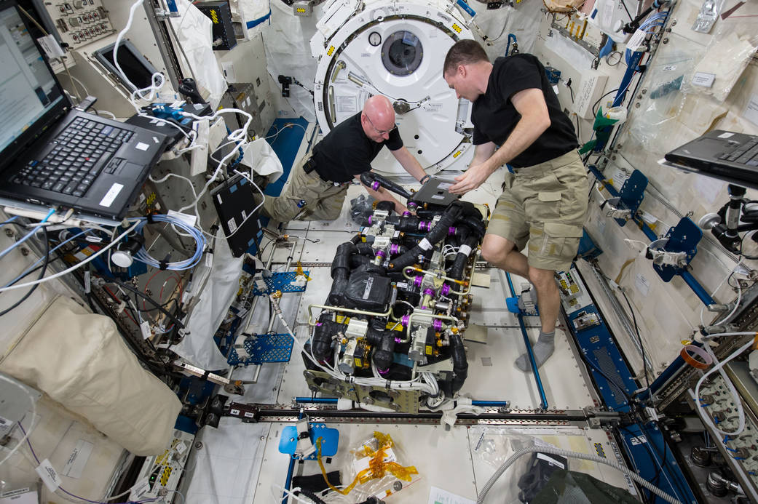
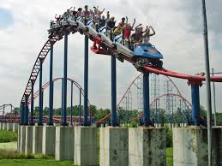
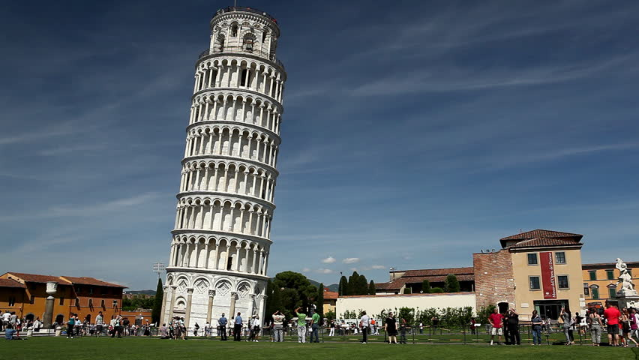
What is “g”? Who experiences more or less than g?
>g, <g? =g?
>g, <g? =g?
>g, <g? =g?
>g, <g? =g?
g=9.8?980?

Slide 45
How does an Accelerometer work?
https://www.youtube.com/watch?v=KZVgKu6v808
http://howtomechatronics.com/how-it-works/electrical-engineering/mems-accelerometer-gyrocope-magnetometer-arduino/

Slide 46
Session 5: How to Measure acceleration using Circuitplayground
#include <Adafruit_CircuitPlayground.h>
#include <Wire.h>
#include <SPI.h>
float x,y,z; //values to measure acceleration in 3 dimensions
void setup() {
CircuitPlayground.begin();
Serial.begin(9600);
}
void loop() {
x=0.0;
y=0.0;
z=0.0;
x=CircuitPlayground.motionX(); //Measures Acc. on x-axis
Serial.print("X: "); Serial.print(x); Serial.println(" m/s/s");
y=CircuitPlayground.motionY(); //Measures Acc. on y-axis
Serial.print("Y: "); Serial.print(y); Serial.println(" m/s/s");
z=CircuitPlayground.motionZ(); //Measures Acc. on z-axis
Serial.print("Z: "); Serial.print(z); Serial.println(" m/s/s");
Serial.println();
delay(500);
}
Print “x”, “y” and “z” accelerations

Slide 47
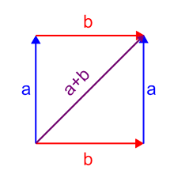

Session 5: Vectors: 3+4 = 5. Really? Yes
b
5
4
C= $\sqrt{a^{2}+b^{2}+2ab\cos\left(α\right)}$
α
3
a
Pythagorean theorem
Vector Addition
Great!! Why do I care?

Slide 48
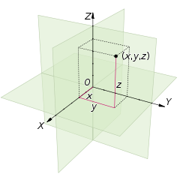


Session 5: Vectors: 3+4+12 = 13
$$=\sqrt{5^{2}+12^{2}}=13$$
12
13
Gravity always acts down, but depending on how the Circuitplayground is oriented, we can have 3 different forces/accelerations – and they all add vector sum to be 9.8
5
4
3
$=\sqrt{3^{2}+4^{2}}=$5

Slide 49
Session 5: Vector sum of all the “accelerations” is ‘g’ ALWAYS!!
void loop() {
x=0.0;
y=0.0;
z=0.0;
float total=0.0;
x=CircuitPlayground.motionX(); //Measures Acc. on x-axis
y=CircuitPlayground.motionY(); //Measures Acc. on y-axis
z=CircuitPlayground.motionZ(); //Measures Acc. on z-axis
total=sqrt((x*x)+(y*y)+(z*z)); //Net force takes the square root of the sum of the squares of the individual forces, Like pythagorean theorem
Serial.print("Total magnitude: ");Serial.print(total); Serial.println(" m/s/s");
Serial.println();
delay(200);
}
There is only one “net” acceleration – ‘g’. NO matter how you break-it-up “x”, “y”, “z”, the result (aka resultant) = g

Slide 50
Session 5: Acceleration >g? How?
void loop() {
if(total>10.0){ //IF the acceleration is greater than the acceleration due to gravity, turn pixel red
CircuitPlayground.strip.setPixelColor(4,255,0,0);
CircuitPlayground.strip.show();
}
else{
CircuitPlayground.strip.setPixelColor(4,0,0,0);
CircuitPlayground.strip.show();
}
getAcc(); //collect magnitude of acceleration
delay(500);
}
void getAcc(){
x=0.0;
y=0.0;
z=0.0;
x=CircuitPlayground.motionX(); //Measures Acc. on x-axis
Serial.print("X: "); Serial.print(x); Serial.println(" m/s/s");
y=CircuitPlayground.motionY(); //Measures Acc. on y-axis
Serial.print("Y: "); Serial.print(y); Serial.println(" m/s/s");
z=CircuitPlayground.motionZ(); //Measures Acc. on z-axis
Serial.print("Z: "); Serial.print(z); Serial.println(" m/s/s");
Serial.println();
total=sqrt((x*x)+(y*y)+(z*z)); //Net force takes the square root of the sum of the squares of the individual forces, Like pythagorean theorem
Serial.print("Total magnitude: ");Serial.print(total); Serial.println(" m/s/s");
Serial.println();
}

Slide 51
Session 5: Acceleration < g? How?
void loop() {
if(total<9.0){ //IF the acceleration is less than the acceleration due to gravity, turn pixel red
CircuitPlayground.strip.setPixelColor(4,255,0,0);
CircuitPlayground.strip.setPixelColor(3,255,0,0);
CircuitPlayground.strip.setPixelColor(2,255,0,0);
CircuitPlayground.strip.setPixelColor(1,255,0,0);
CircuitPlayground.strip.show();
}
else{
CircuitPlayground.strip.setPixelColor(4,0,0,0);
CircuitPlayground.strip.setPixelColor(3,0,0,0);
CircuitPlayground.strip.setPixelColor(2,0,0,0);
CircuitPlayground.strip.setPixelColor(1,0,0,0);
CircuitPlayground.strip.show();
}
getAcc(); //collect magnitude of acceleration
delay(500);
}
void getAcc(){
x=0.0;
y=0.0;
z=0.0;
x=CircuitPlayground.motionX(); //Measures Acc. on x-axis
Serial.print("X: "); Serial.print(x); Serial.println(" m/s/s");
y=CircuitPlayground.motionY(); //Measures Acc. on y-axis
Serial.print("Y: "); Serial.print(y); Serial.println(" m/s/s");
z=CircuitPlayground.motionZ(); //Measures Acc. on z-axis
Serial.print("Z: "); Serial.print(z); Serial.println(" m/s/s");
Serial.println();
total=sqrt((x*x)+(y*y)+(z*z)); //Net force takes the square root of the sum of the squares of the individual forces, Like pythagorean theorem
Serial.print("Total magnitude: ");Serial.print(total); Serial.println(" m/s/s");
Serial.println();
}

Slide 52
Session 5: Acceleration < g? How?
void loop() {
getAcc(); //collect magnitude of acceleration
if(total>11){ //IF the acceleration is greater than the acceleration due to gravity, turn pixel red
redSpark();
}
else if(total<9.0&&total>7.0){
greenSpark();
}
else if(total<7.0&&total>3.0){
tealSpark();
}
else if(total<3.0){
blueSpark();
}
else{
amberSpark();
}
delay(500);
}
void redSpark(){
for(int i=0;i<=10; i++){
CircuitPlayground.strip.setPixelColor(i,255,0,0);
CircuitPlayground.strip.show();
}
}
void greenSpark(){
for(int i=0;i<=10; i++){
CircuitPlayground.strip.setPixelColor(i,0,255,0);
CircuitPlayground.strip.show();
}
}
void blueSpark(){
for(int i=0;i<=10; i++){
CircuitPlayground.strip.setPixelColor(i,0,0,255);
CircuitPlayground.strip.show();
}
}
void tealSpark(){
for(int i=0;i<=10; i++){
CircuitPlayground.strip.setPixelColor(i,0,255,255);
CircuitPlayground.strip.show();
}
}
void amberSpark(){
for(int i=0;i<=10; i++){
CircuitPlayground.strip.setPixelColor(i,255,255,0);
CircuitPlayground.strip.show();
}
}

Slide 53

Have a GREAT SUMMER!!! Stay SAFE!!

